Slide 1

1)AKHIL JATIA
2) DEVANSH GINORIA
TEAM TECH TITANS
Learn new skills
GENSKILL
A tool that generates unpredictable, unique skills to inspire creativity, learning, or character development instantly.

Slide 2


PROBLEM STATEMENT
In today’s fast-paced and diverse world, people struggle to identify new skills for personal growth, career development, or hobbies. The overwhelming number of options online causes decision fatigue and low motivation. A simple, engaging, open-source AI-friendly sustainable tool is needed to recommend random skills based on user interests, categories, or at random, helping users explore fresh learning paths with ease.
The Random AI- Powered Skill Generator offers users a curated, category-based list of skills — from technical and creative to soft skills and daily life skills. It helps students, professionals, and lifelong learners break monotony, spark curiosity, and discover new abilities they may not have considered.
Drag and drop your photo or video! Click the sample photo or video and delete. Select yours from the Uploads tab, drag, and then drop inside the frame!

Slide 3

TARGET AUDIENCE
IMPACT
1. Students (both college and school)
Why? They frequently look for ways to improve their skills or explore new interests.
Use Case: Choose skills for personal development, improve resumes, or find new interests.
2. Professionals in the Workforce
Why? In their spare time, many people wish to learn technical skills, soft skills, or creative pastimes.
Use Case: Change careers, increase productivity, or break up routine.
3. Educators and Teachers
Why? to recommend to students new abilities or small projects.
Use Case: Incorporate it into growth-oriented activities or icebreakers in the classroom.
1. Encourages Exploration
2. Promotes Personal Growth
3. Boosts Resume and Portfolio
4. Improves Confidence & Motivation
5. Saves Time in Skill Selection
6. Fuels Peer Learning & Social Sharing
7. Supports Mental Well-being
TEAM TECH TITANS

Slide 4
Skill Path Generator Once a skill is chosen, it generates: Top free/paid learning resources (YouTube, Coursera, GitHub). Beginner roadmap with tools, timelines, and project ideas.
AI-Driven Personalization NLP-based user interest input (keywords or short text). Uses prompt engineering to map interests → skill categories → personalized suggestions. .
Skill Randomizer Engine Smart filters: Technical, Creative, Soft Skills, Daily Life, Career Boosters. Option to shuffle skill suggestions by mood, goal, or time available.
PROPOSED SOLUTION

Slide 5

ABOUT US
AKHIL JATIA-I AM A FRESHER STUDYING COMPUTER SCIENCE ENGINEERING IN VIT CHENNAI .I HAVE A BUDDING INTEREST IN THE FIELD OF ARTIFICIAL INTELLIGENCE AND MACHINE LEARNING.I HAVE WORKED ON A FEW PROJECTS BASED ON ARTIFICIAL INTELLIGENCE AND WEB DEVELOPMENT
2.DEVANSH GINORIA:I AM A FRESHER STUDYING COMPUTER SCIENCE ENGINEERING AT VIT CHENNAI . I HAVE KNOWLEDGE OF FRONT END DEVELOPMENT AND IS KEEN IN LEARNING ABOUT ARTIFICIAL INTELLIGENCE AND MACHINE LEARNING.I HAVE COMPLETED VARIOUS PROJECTS AND ALSO LOVES TO SOLVE DSA

Slide 6






TECH STACK
LANGUAGES
FRAMEWORK
PYTHON
JAVASCRIPT
HTML
CSS
FLASK
DJANGO

Slide 7
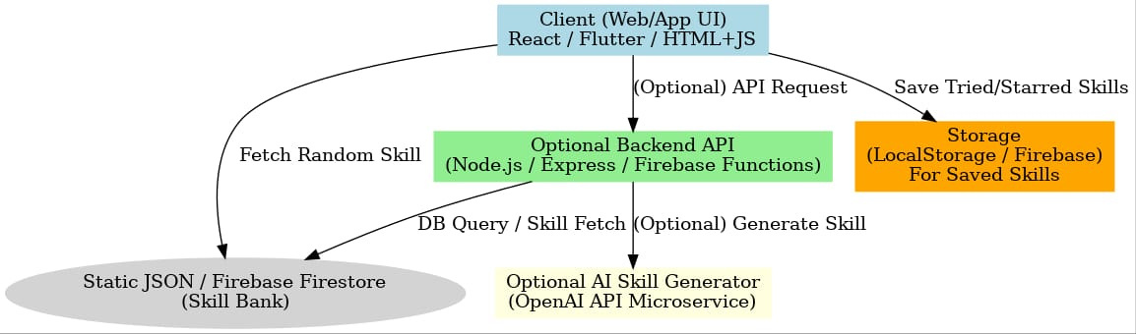
ARCHITECTURE DESIGN

Slide 8
PRODUCT FLOW
Random Skill Generator
CHOOSE SKILL?
NO
SKILL
List of tools
END

Slide 9
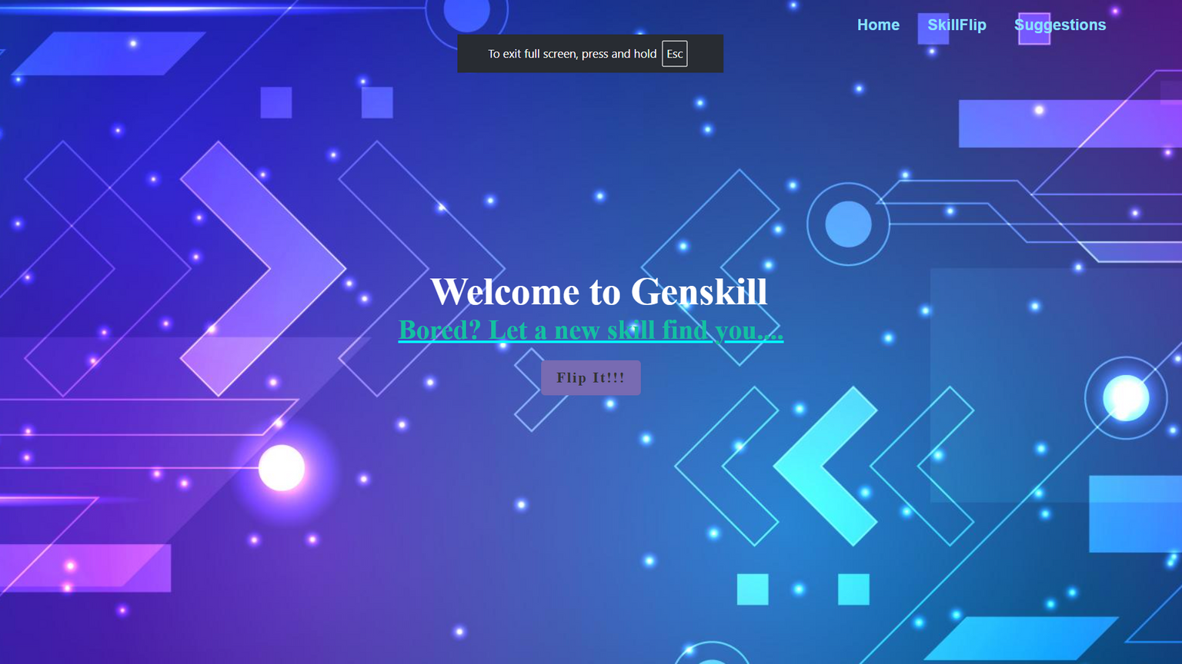
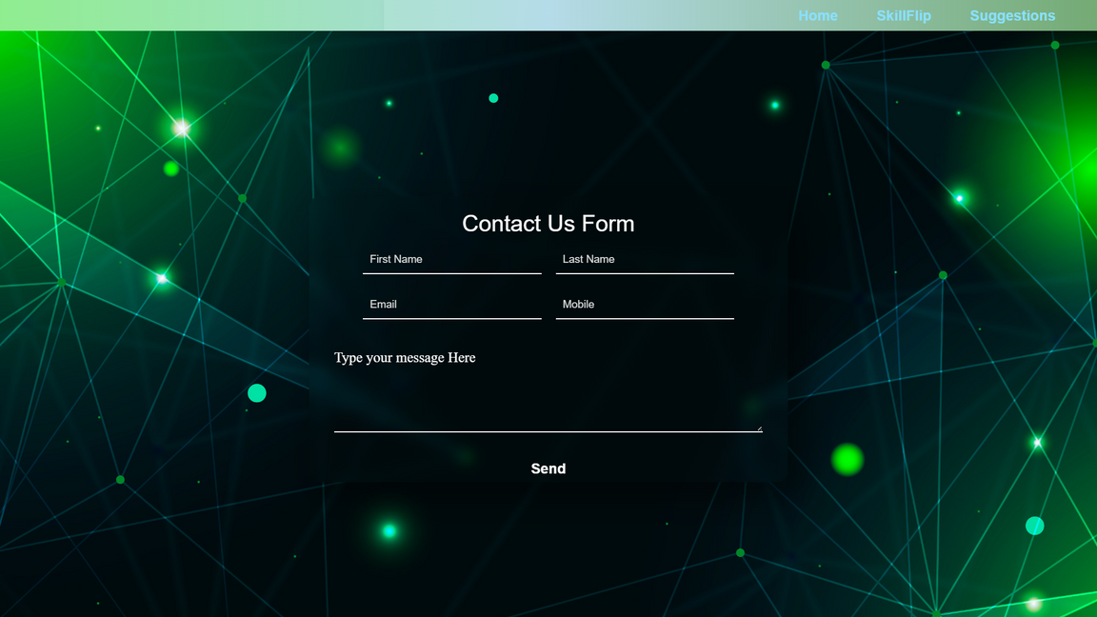
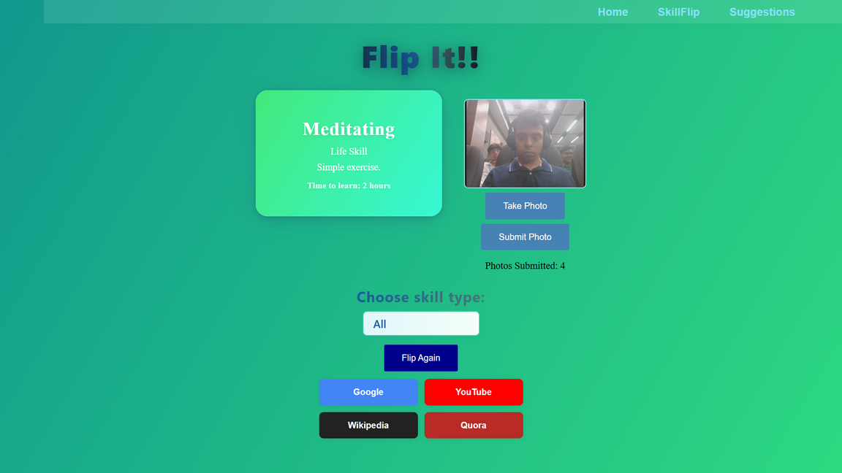
PRODUCT DEMO

Slide 10
CHALLENGES
LEARNINGS
Skill Categorization Logic: Mapping skills accurately under multiple categories like technical, creative, soft skills, etc., without overlap.
Filtering by Skill Level: Designing a system to classify skills as Beginner, Intermediate, or Advanced proved tricky without clear standards.
UI/UX Design Constraints: Making the interface intuitive and engaging within limited hackathon time.
Data Management: Managing a clean and non-repetitive skill database.
User-Centric Design: Small UI changes made a big difference in user experience.
Team Collaboration: Dividing roles boosted speed and avoided duplication.
Tech Stack Optimization: Learned efficient use of APIs and tools for scalability.
Prototyping Skills: Rapid prototypes helped us test ideas quickly.
Real-World Thinking: Realized how random tools can boost motivation to learn.

Slide 11

FUTURE SCOPES
AI-Powered Recommendations:
Use user behavior and preferences to suggest personalized skills using machine learning.
Skill Progress Tracking
Allow users to track their learning journey with checklists, milestones, and certificates.
Integration with Learning Platforms
Directly link each skill to curated courses/videos from YouTube, Coursera, Udemy, etc.
Mobile App Version
Develop a lightweight mobile app for easier and on-the-go access.
Multi-language Support
Make the tool accessible to non-English users with translations.

